Slide 1

Welcome to
Coffee And Brew

Slide 2
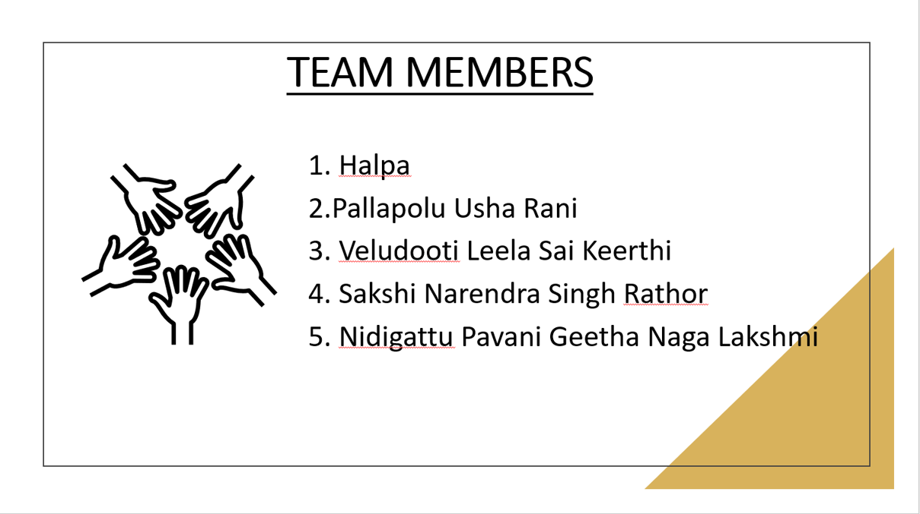

TEAM MEMBERS
1. Halpa
2.Pallapolu Usha Rani
3. Veludooti Leela Sai Keerthi
4. Sakshi Narendra Singh Rathor
5. Nidigattu Pavani Geetha Naga Lakshmi

Slide 3
CONTENTS
Project case study
Introduction
System Requirements
ER Diagram
Mapping
Result Of Mapping
Testing Result
1.Unit Testing
2.Integration Testing
3.Regression Testing
Conclusion

Slide 4

Project Case Study
'Coffee & Brew', a very popular Starbucks outlet in Connaught Place , Delhi that sells different products to its customers. Their weekday foot falls has not seen improvement over the last 12 months. To accelerate their business, they plan to increase their sales on weekdays. To achieve this target, ‘Coffee & Brew’ is looking to attract clientele, mainly youth and teenagers, by launching various promotional offers that appeal to them. To get that insight, 'Coffee & Brew’ wants to create a Data Warehouse solution on which they can do data analytics.

Slide 5
Introduction
'Coffee & Brew', a very popular Starbucks outlet in Connaught Place, Delhi which sells different products to the customers. The weekday foot falls has not seen improvement over the last 12 months.
To accelerate the improvement of the sales and to grab attention of the teenagers and youth, we are providing the offer in weekdays up to 30% according to customer type and price of the product that is greater than 500.

Slide 6
System Requirement
Oracle 11g
Informatica Power Center v10.x
Device configuration – Min 8GB RAM, Min 100GB Disk, Windows 10

Slide 7
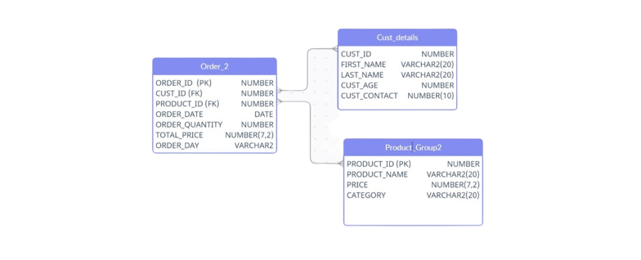
ER Diagram

Slide 8
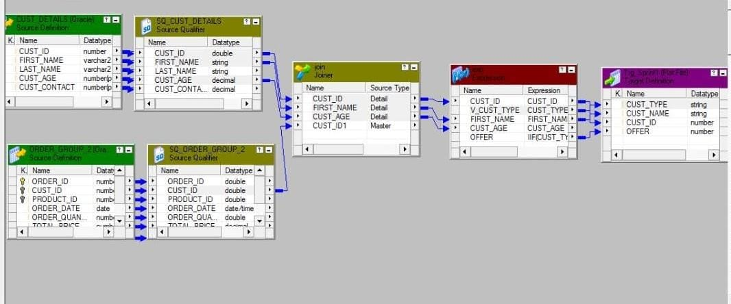
Mapping
First Mapping
Mapping from CUST_DETAILS and ORDER_2 (source table) to TRG_SPRINT1(flat file)

Slide 9
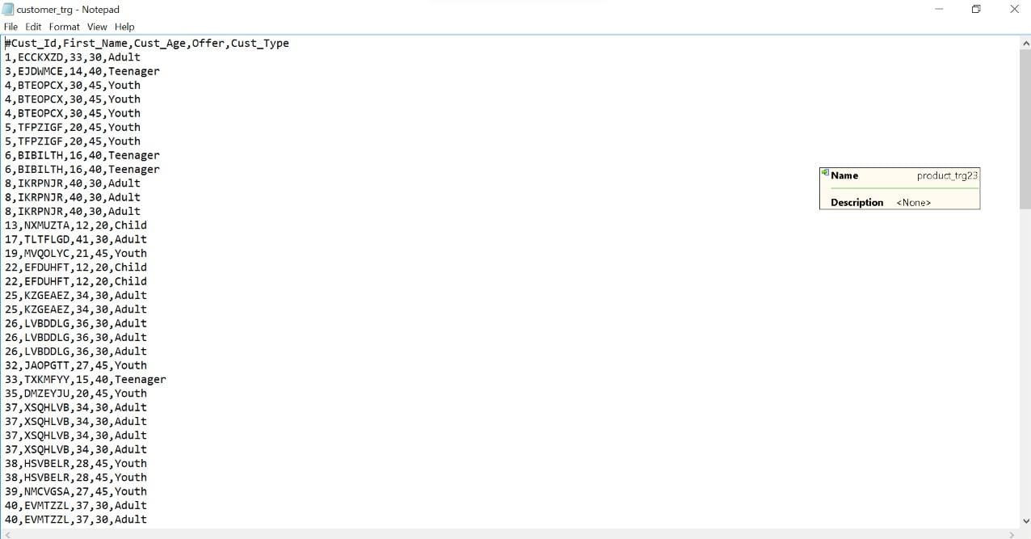
Result Of First Mapping

Slide 10
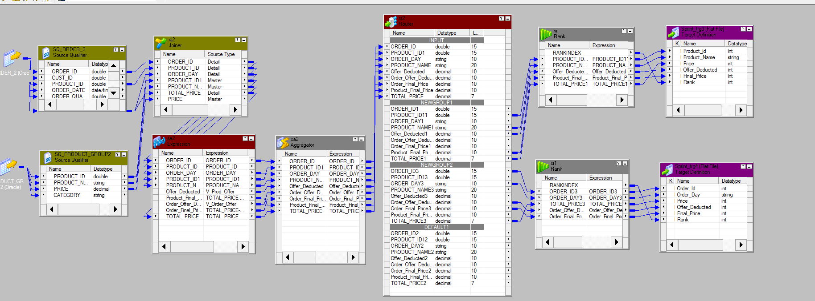
Second Mapping Mapping from ORDER_2 AND PRODUCT_GROUP2 (source table) to TRG_PRODUCT AND TRG_ORDER(Flat File)

Slide 11
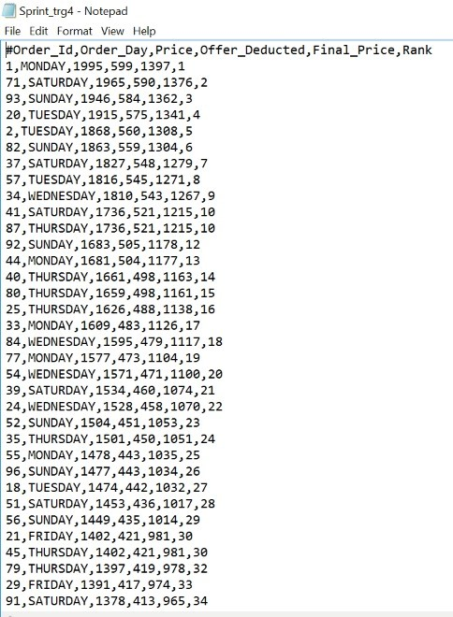
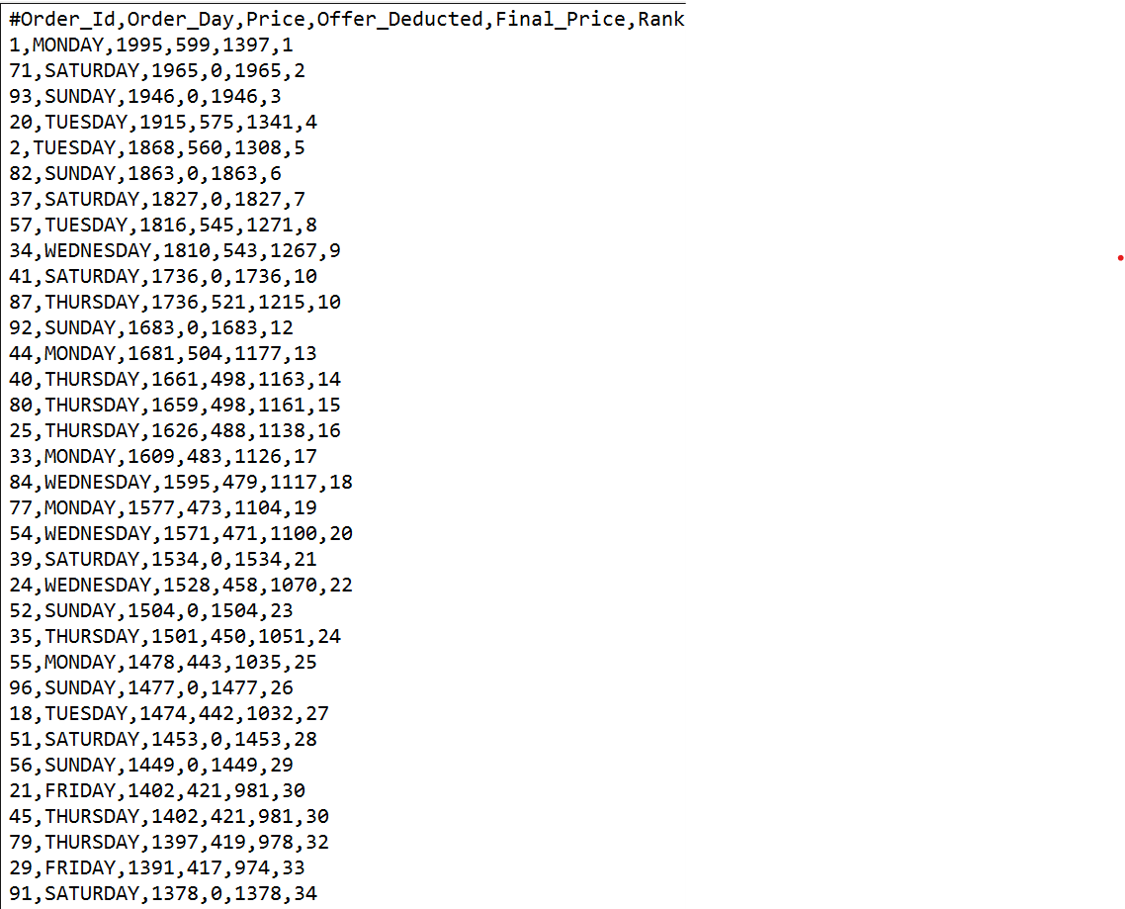
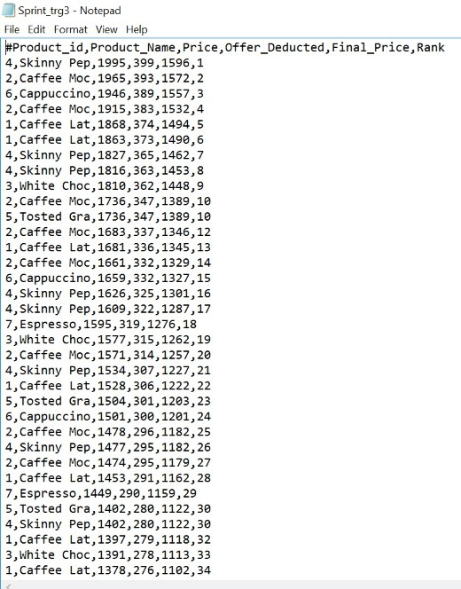
Result Of Second Mapping
Result of TRG_ORDER
Result of TRG_PRODUCT

Slide 12
Testing Result
UNIT TESTING
1) Test Case ID: T1
Test Case Purpose: Validate workflow : w_m_map_Sprint
Test Procedure:
Input Value/Test Data: Sources and targets are available and connected
Source: Order_2, Cust_Details
Mapping: w_m_map_sprint2
Target: Customer_trg
Session: s_m_map_Sprint

Slide 13
Transformations:
Joiner
Expression
Router
Expected Results: Message in workflow manager status bar: “Workflow w_s_m_map_Sprint is valid”
Actual Results: Message in workflow manager status bar: “Workflow w_s_m_map_Sprint is valid”
Tester Comments: Retrieved the data from source tables Cust_details and Order_2, joined the two tables using ‘Joiner’ transformation. We used ‘Expression’ transformation to derive the Cust_type and offer based on Cust_type. The output will be show in flat files. The output is useful to identify the customer type and offer given to them.

Slide 14
2) Test Case ID: T2
Test Case Purpose: Validate workflow : w_s_m_map_Sprint2
Input Value/Test Data: Sources and targets are available and connected
Sources: Order_2, Product_Group2
Mapping: m_map_Sprint2
Targets: Order_trg_2, Product_trg2
Session: s_m_map_Sprint2

Slide 15
Transformations:
Joiner
Expression
Aggregator
Router
Rank
Expected Results: Message in workflow manager status bar: “Workflow w_s_m_map_Sprint2 is valid.”
Actual Results: Message in workflow manager status bar: “Workflow w_s_m_map_Sprint2 is valid”
Remarks: Succeeded
Tester Comments : Retrieved the data from source tables Order_2 and Product_Group2. We are giving offer to those customers whose Total_price >=500. The output will be shown in flat files. The output target table Order_trg2 and Product_trg2 are useful to identify the offer deducted to the customer and the Final_Price that they have to pay.

Slide 16
Integration-Testing
It is a type of Software testing in which the different units, modules, or components of a software application are tested as a combined entity.
We will check here functionality of the mappings.
There are 2 mappings.
1.m_map_Sprint
2.m_map_Sprint2
Test Case ID: M1
Test Case Purpose: Validate Mapping, m_map_Sprint, Validate Workflow, w_s_m_map_Sprint

Slide 17
Test Procedure:
Input Value/Test Data:
Source Tables: Order_2, Cust_Details
Target Tables: Customer_trg
Transformation:
Joiner
Expression
Excepted Result: Message in workflow manager status bar: “Workflow w_s_m_map_Sprint is valid”
Actual Result: Message in workflow manager status bar: “Workflow w_s_m_map_Sprint is valid”
Remarks: Succeeded
Tester comments: Retrieved the data from source tables Cust_details and Order_2, joined the two tables using ‘Joiner’ transformation. We used ‘Expression’ transformation to derive the Cust_type and offer based on Cust_type. The output will be show in flat files. The output is useful to identify the customer type and offer given to them

Slide 18
Test Case ID: M2
Test Case Purpose: Validate Mapping, m_map_Sprint2, Validate Workflow, w_s_m_map_Sprint2.
Test Procedure:
Input Value/Test Data:
Source Tables: Order_2, Product_Group2
Target Tables: Order_trg2, Product_trg2
Transformation:
Joiner
Expression
Aggregator
Router
Rank

Slide 19
REGRESSION TESTING
Every time a new module is added, it leads to changes in the program. This type of testing makes sure that the whole component works properly even after adding components to the complete program.
We will check here functionality of the mappings.
There are 2 mappings:
1.m_map_Sprint
2.m_mapp_Sprint2
Test Case ID: M1
Test Case Purpose: Validate Mapping, m_map_Sprint, Validate Workflow, w_s_m_map_Sprint2
Test Procedure

Slide 20
Input Value/Test Data:
Source Tables: Order_2, Cust_Details
Target Tables: Customer_trg
Transformation:
Joiner
Expression
Expected Result: Go to workflow > Message in workflow manager status bar: “Workflow w_s_m_map_Sprint is valid”
Actual Result: Message in workflow manager status bar: “Workflow w_s_m_map_Sprint is valid”
Remarks : Succeeded
Tester comments : Retrieved the data from source tables Cust_details and Order_2, joined the two tables using ‘Joiner’ transformation. We used ‘Expression’ transformation to derive the Cust_type and offer based on Cust_type. The output will be show in flat files. The output is useful to identify the customer type and offer given to them

Slide 21
2) Test Case ID: T2
Test Case Purpose: Validate workflow – w_s_m_map_Sprint2
Input Value/Test Data:
Sources: Order_2, Product_Group2
Targets: Order_trg_2, Product_trg2
Mapping: m_map_Sprint2
Session: s_m_map_Sprint2
Transformations:
Joiner
Expression
Aggregator
Router
Rank

Slide 22
Expected Results: Message in workflow manager status bar: “Workflow w_s_m_map_Sprint2 is valid”
Actual Results: Message in workflow manager status bar: “Workflow w_s_m_map_Sprint2 is valid”
Remarks: Succeeded
Tester Comments: Retrieved the data from source tables Order_2 and Product_Group2. We are giving offer to those customers whose Total_price >=500. The output will be shown in flat files. The output target table Order_trg2 and Product_trg2 are useful to identify the offer deducted to the customer and the Final_Price that they have to pay.

Slide 23
Conclusion
The entire project has been developed and deployed as per the requirements, it is found to be bug free as per the testing standards that are implemented.
Finally, we would like to conclude that we put all our efforts throughout the development of our project and tried to fulfill the requirements.

Slide 24


